Slide 2
IOYFT CASAL/Casal2 Simulation
Craig Marsh Jeremy McKenzie Teresa A’mar

Slide 3
Presentation
Recap webinar results for 1A and FAA models
4 Area CASAL 2 model results (new)
Seasonal 1A model results (new)
Questions

Slide 4
Recap
CASAL 1 structural limitation
CASAL 1 can only fit to catch as numbers as a “weightless model” mean B0 is expressed as numbers not weight.
Our 1A and FAA Casal 1 assessments all assume the provided values are in tonnes not numbers (i.e. CPUE indices as biomass not abundance)
Casal 2 can deal with catch as numbers so we undertook both “as biomass” and as numbers runs

Slide 5
Recap
Characterisation to understand the fishery and available data
Model development (general approach was to start simple and build complexity)
1A model Casal 1
FFA model Casal 1
4A model Casal 2 (new results)
Retained to the pseudo-year temporal structure in the observational data sets

Slide 6
Recap
1A model
Compositional likelihoods (7)
1A model fisheries Selectivity ogive (all length-based)
fishing_bb_proportions double-normal (estimated)
fishing_gi_proportions double-normal (estimated)
fishing_hd_proportions double-normal (estimated)
fishing_ll_proportions logistic (estimated)
fishing_other_proportions double normal plateau (estimated)
fishing_ps_proportions double-normal (estimated)
fishing_trol_proportions double normal plateau (estimated)
Abundance likelihood
Longline CPUE
Estimated parameters: B0, annual recruitment devs, selectivity parameters, LL CPUE q
Fitting: Based on likelihood improvement and residual analysis
Explored alternative selectivity ogives
Employed Francis (2011) reweighting

Slide 7
Recap
1A model Longline CPUE

Slide 8
Recap
1A model Compositional fits

Slide 9
Recap
1A model Compositional Pearson residuals
fishing_bb
fishing_gi
fishing_hd
fishing_other
fishing_ps
fishing_ll

Slide 10
Recap
1A model Estimated selectivities

Slide 11
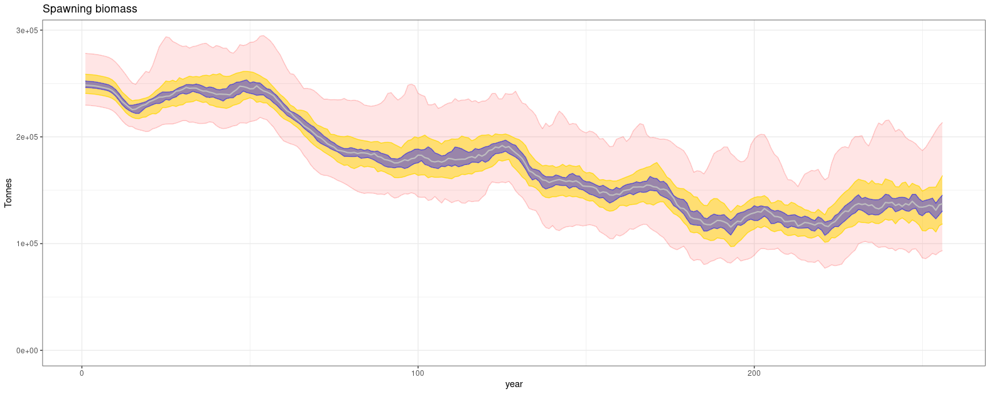
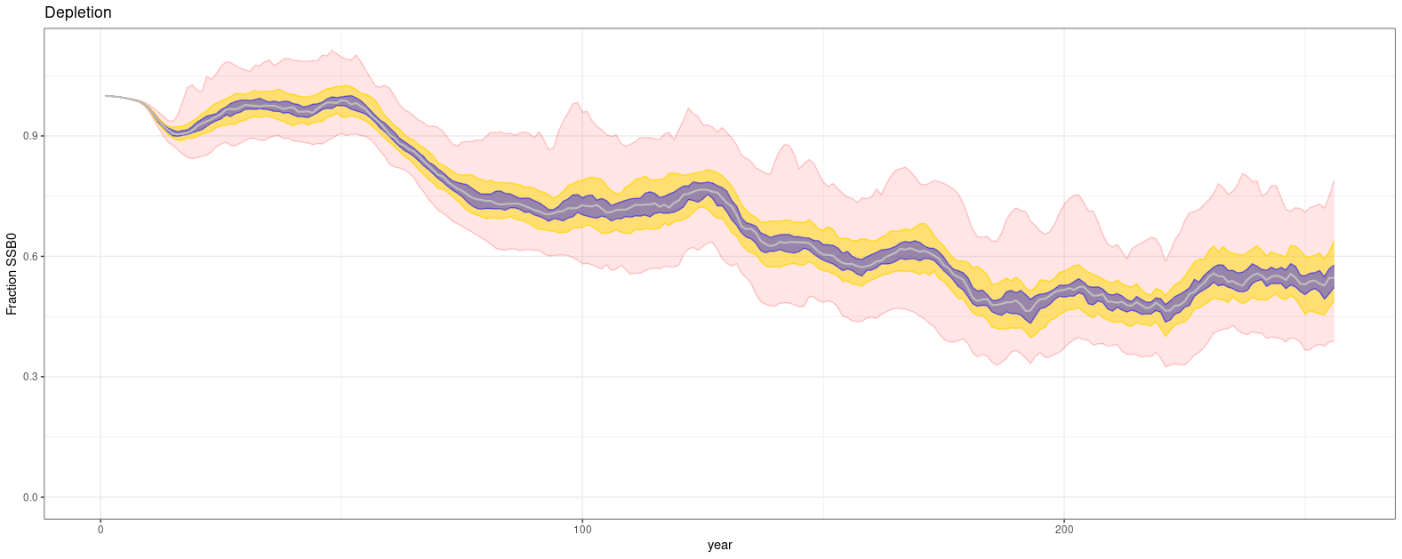
Recap
1A model 100 realisation MPD results

Slide 12
Recap
FAA model
Compositional likelihoods
FAA model fisheries Fleet areas Selectivity ogive (all length based)
fishing_bb_proportions 1 double-normal
fishing_gi_proportions 1,4 double-normal
fishing_hd_proportions 1 double-normal
fishing_ll_proportions 1,2,3,4 mixture of logistic and logistic capped
fishing_other_proportions 1 double normal plateau
fishing_ps_proportions 2,4 double-normal
fishing_trol_proportions 1,4 double normal plateau
Abundance likelihood
4-area Longline CPUE indices
Estimated parameters: B0, annual recruitment devs, selectivity parameters, LL CPUE q (single)
Fitting: Based on likelihood improvement and residual analysis
Explored alternative selectivity ogives
Employed Francis (2011) reweighting

Slide 13
Recap
FAA model Change in model fit to the longline fleet-area CPUE indices are a result of changing longline selectivity to capped logistic

Slide 14
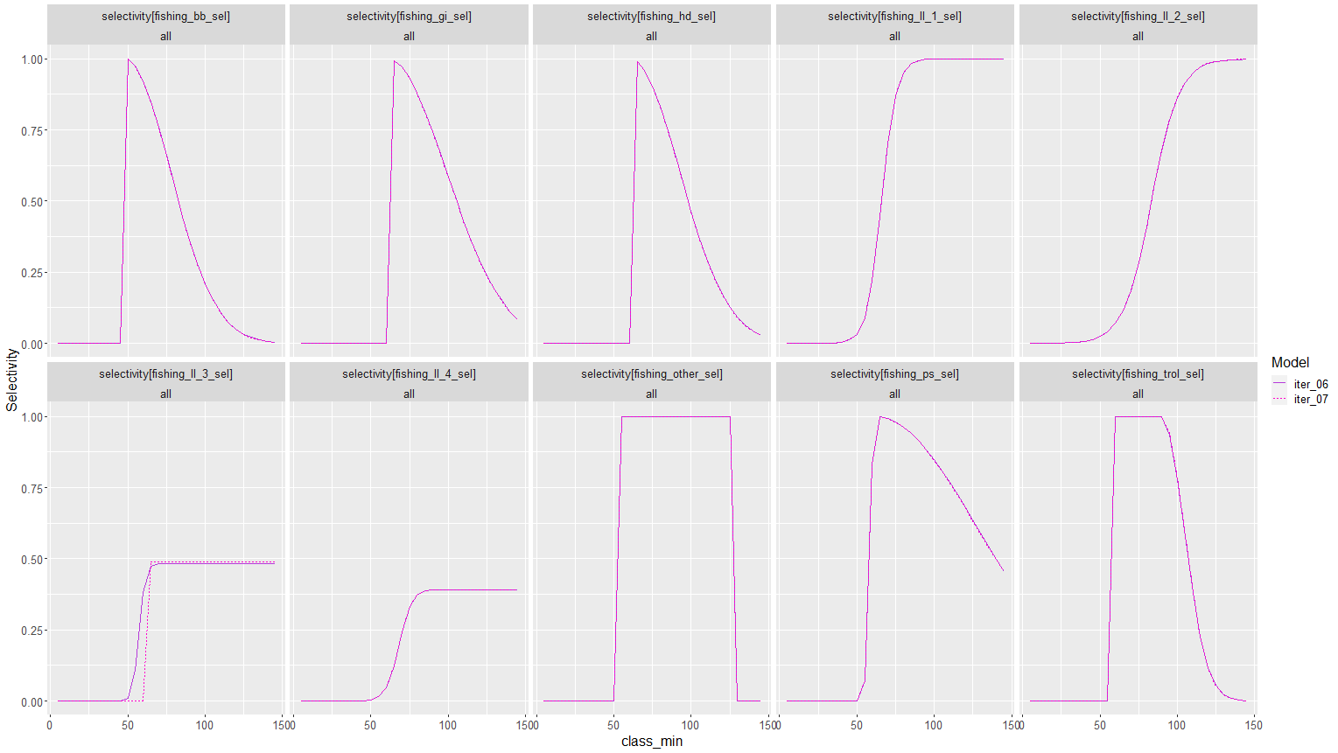
Recap
FAA model Change in model fit to the longline fleet-area CPUE indices are a result of changing longline selectivity to capped logistic

Slide 15
Recap
FAA model
Strong trends evident in some of the long-line CPUE fleet-area residuals

Slide 16
Recap
FAA model Compositional fits

Slide 17
Recap
FAA model Compositional fits

Slide 18
Recap
FAA and 1A model Estimated true recruitment deviates

Slide 19
Recap
FAA & 1A model SBB and stock status trajectories

Slide 20
4A Model
Craig Marsh …

Slide 21
1A model Configured as true annual with 4 seasons
Needed to reconfigure length at-age & maturity at age vectors
Casal 1 cannot allocate recruitment deviates across multiple seasons so only 1 annual recruitment deviate estimated assigned to season 2

Slide 22
1A model Configured as true annual with 4 seasons
Abundance fits

Slide 23
1A model Configured as true annual with 4 seasons
Compositional fits

Slide 24
1A model Configured as true annual with 4 seasons
Compositional fits

Slide 25
1A model Configured as true annual with 4 seasons
Compositional fits

Slide 26
1A model Configured as true annual with 4 seasons
Compositional fits

Slide 27
1A model Configured as true annual with 4 seasons
Recruitment Deviates

Slide 28
1A model Configured as true annual with 4 seasons
SSB and stock status trajectories

Slide 29
Model summary table

Slide 30


Thanks
ACKNOWLEDGMENTS
Fisheries New Zealand
Indian Ocean Tuna Commission

